Slide 1

LOANS

Slide 2
What is a Bank Loan?
A bank gives money
To an individual or a company
With the agreement that it will be paid back
With interest
Within a time limit

Slide 3
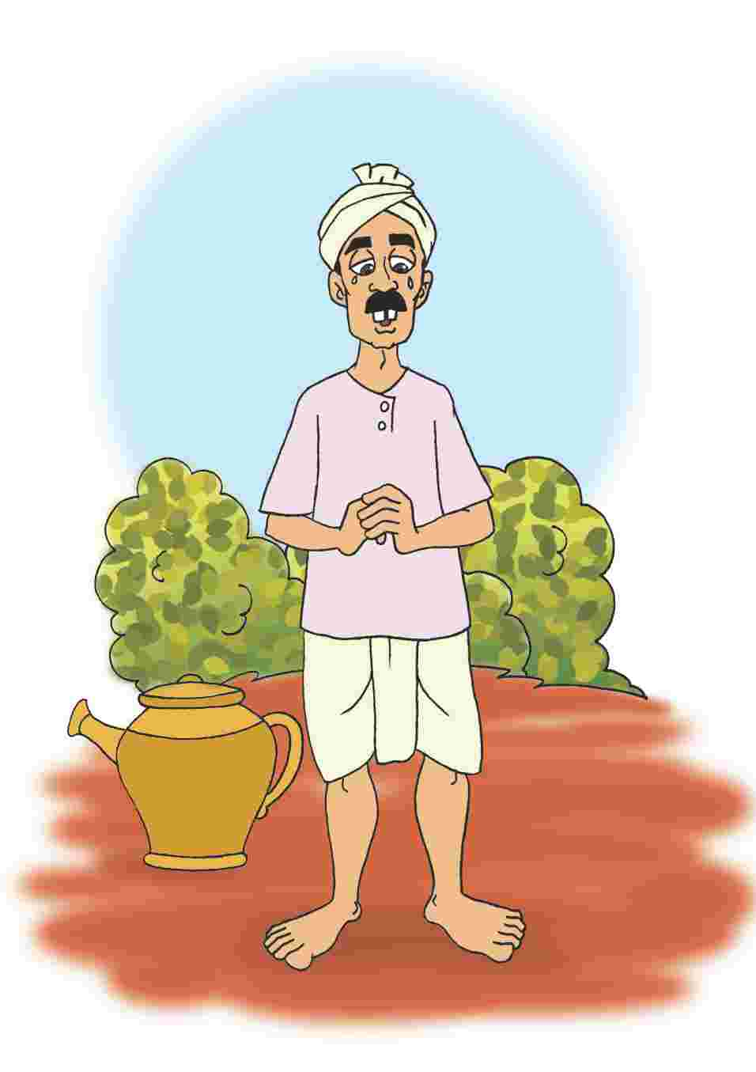
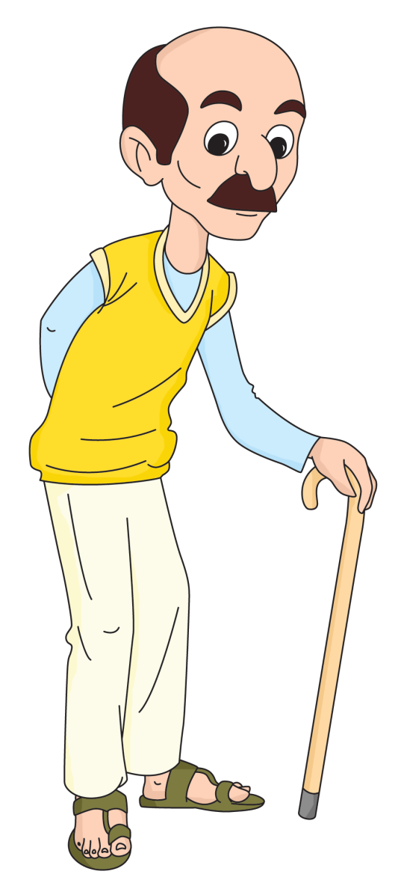
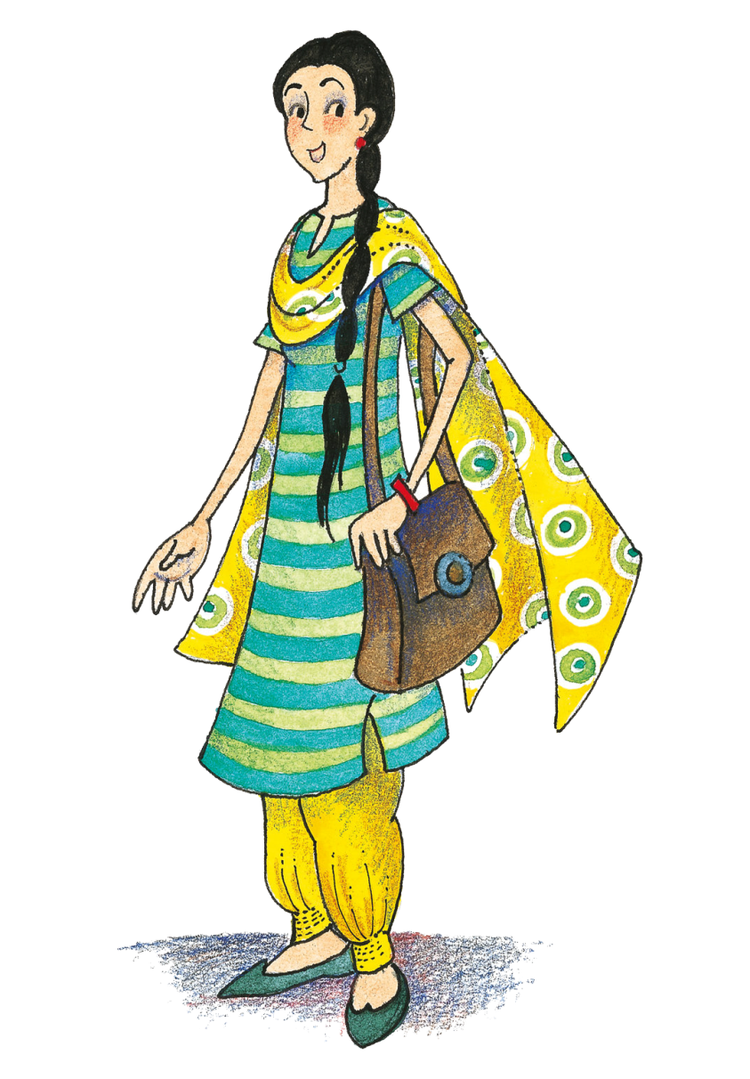

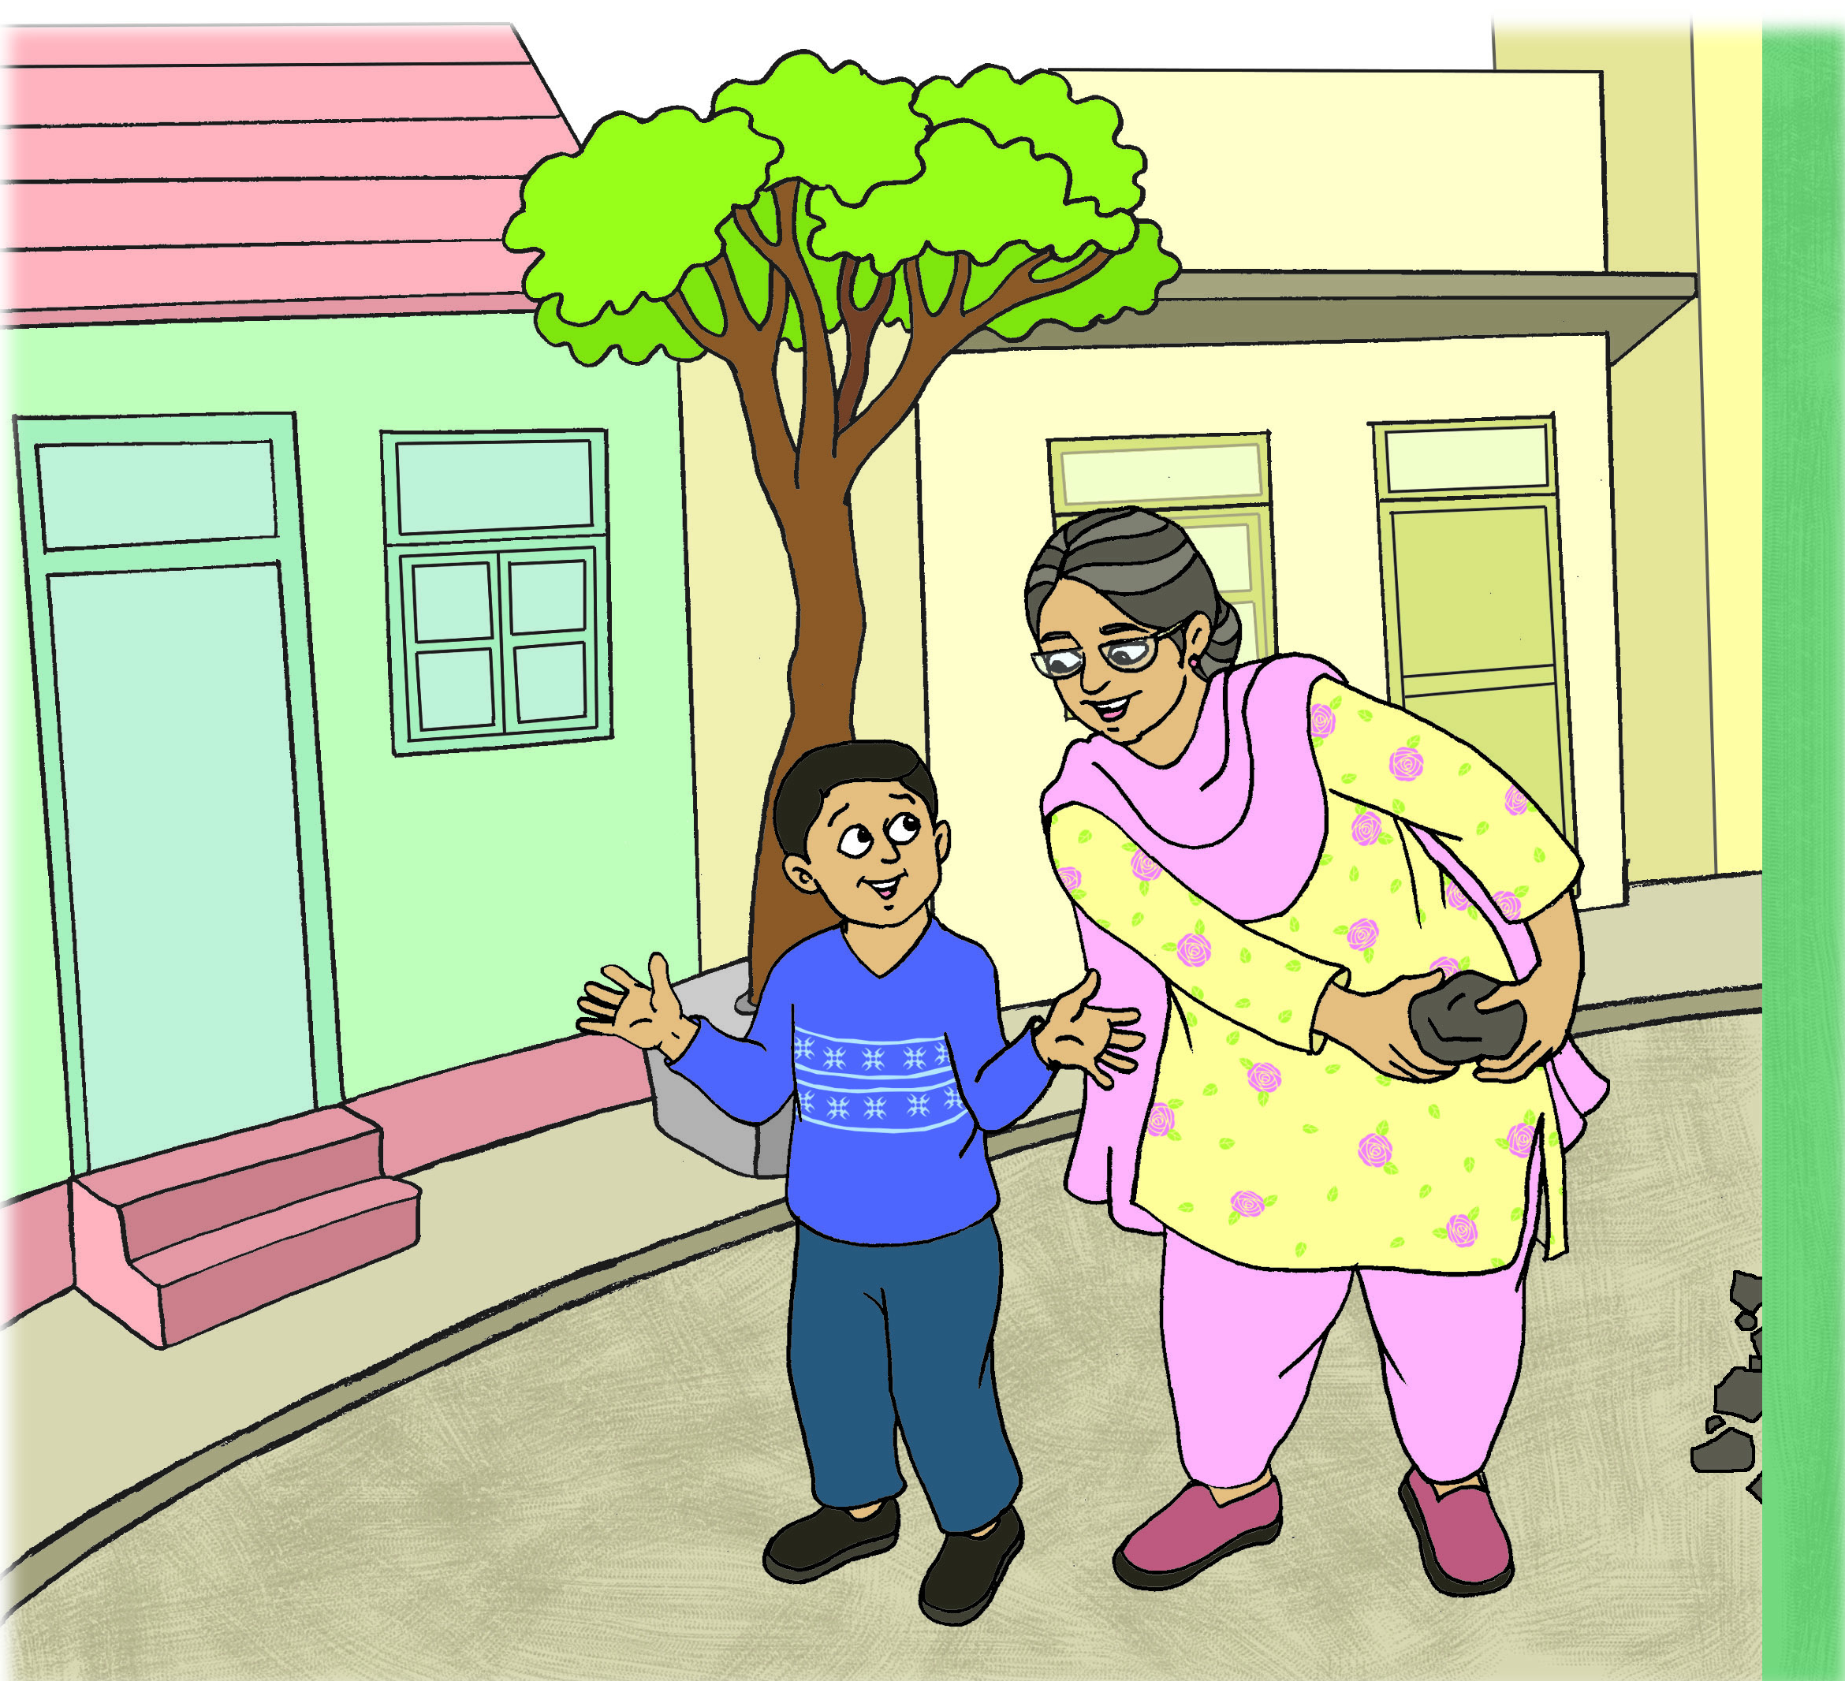
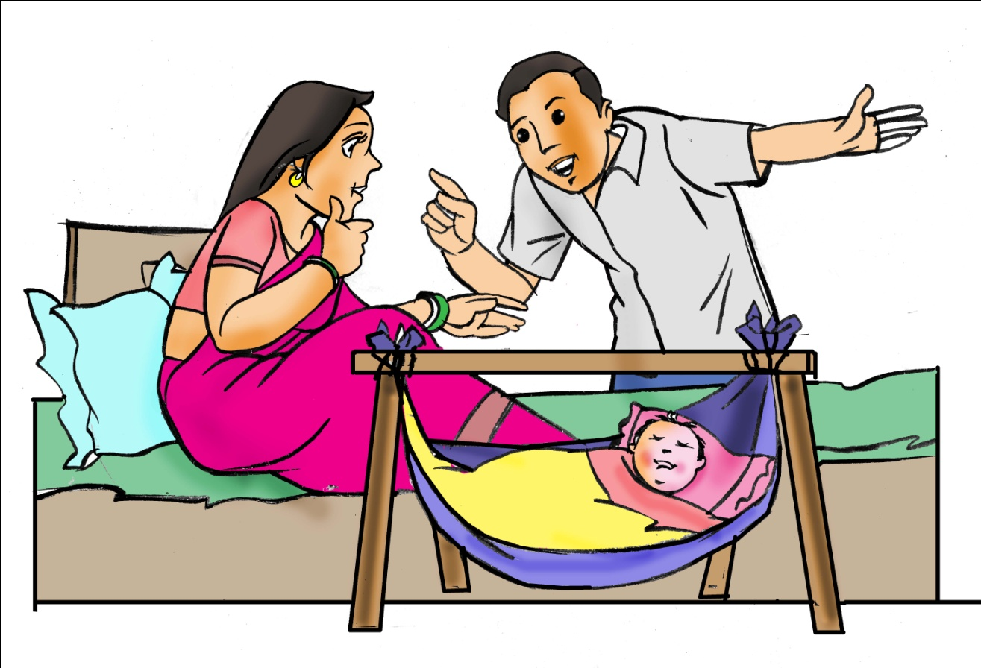
Are there different types of loans?
I have a growing family. I need to buy a new house. I can’t pay the whole amount. What do I do?
It is October and I have to start sowing wheat. But I need money for equipment and labour
My son is getting married this year and I need money for the expenses
It takes long to drop my son to school and go to office. I need to buy a two wheeler. How do I get the money?
I want to pursue a masters degree in english. I don’t want to ask my parents for the fees
I want to open a new garage. I know all the costs and I have a plan. But where do I get the money?
A bank can give you a personal loan that will help you pay for your expenses
A bank can give you an education loan. All expenses like tuition, books, lodging are covered in this.
A bank can give you an agricultural loan that will help you pay for your need
A bank can give you a home loan for buying a new house. You will have to pay some amount while the rest will be paid by the bank
A bank can give you an auto loan for buying a new two wheeler. You will have to pay some amount while the rest will be paid by the bank
A bank can give you a business loan for starting up and running your day to day business

Slide 4

How can I get a bank loan?
The bank will check a few things before giving you the loan
Earning capacity – check that you are able to earn enough money
Repayment capacity – check that you are able to pay back the loan
Income Tax Returns Filing – check that you have filed your income tax returns regularly
Other Loans – check if you have taken any other loans

Slide 5
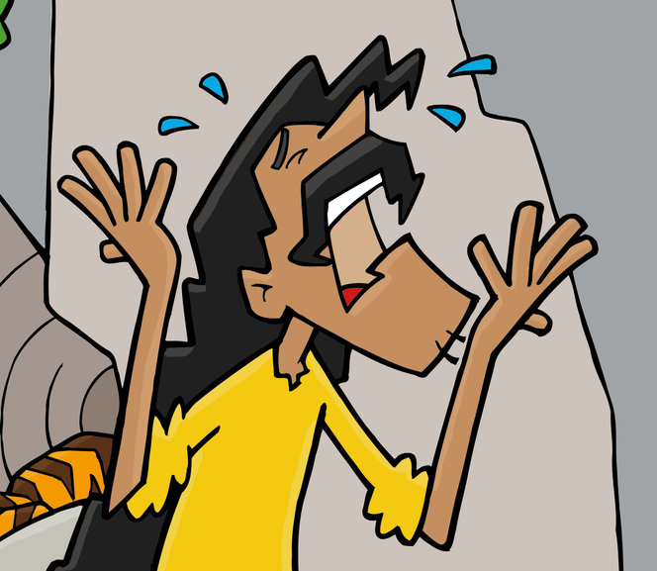
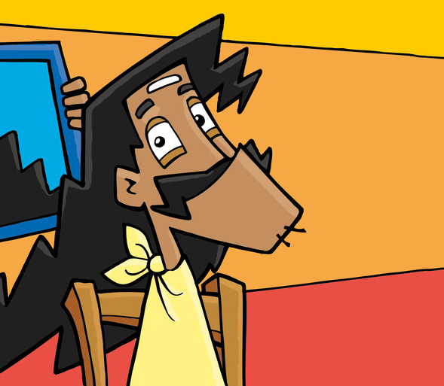
How is a bank loan returned?
Thank God! So I have to return Rs. 2 Lakhs little by little every month until its paid back?
If I take a loan of Rs. 2 Lakhs how will I pay back the whole amount at one time?
Yes. But you also need to pay a charge for taking a loan. This is called Interest. It is percentage of the loan and depends on the amount and the time period for which you have taken the loan
Relax! You don’t have to pay the entire amount back at one time. You pay the amount back bit by bit every month. This is why it is called EMI or Equated Monthly Installments

Slide 6
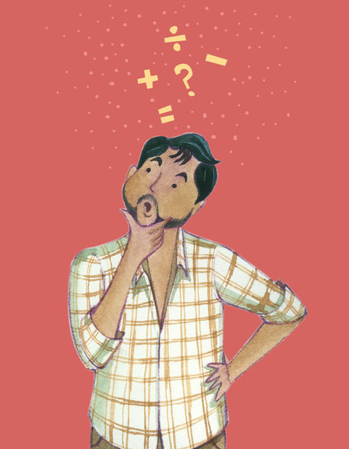
Can I pay off the loan before time?
I have got a bonus! Can I pay off the loan before time?
Yes. But check with your bank if there are any conditions or charges for pre-paying the loan.

Slide 7

What if I cannot pay back my loan?
My business is not growing as quickly as I thought! What if I cannot pay back the loan?
A bank loan is a legal agreement
The bank may:
Take legal action
Confiscate collateral
Share repayment details with other banks
Charge penal interest

